Slide 1
Course Teacher: Muhammad Ali Khan
Fall Semester 2021
Course title: Business Communication
Formal Reports
Adapted by Sir Khan

Slide 2
Present
the final
report
Research
secondary
data
Illustrate
report
data
Formal
Reports
Generate
primary
data
Organize
report
data
Document
data

Slide 3

Researching Secondary Data
Compiled by Sir Muhammad Ali Khan
Print Resources
Books
Periodicals
Bibliographic indexes such as Reader’s Guide
Electronic Databases
Collections of magazine,
newspaper,
journal articles
Thesis/Reports

Slide 4
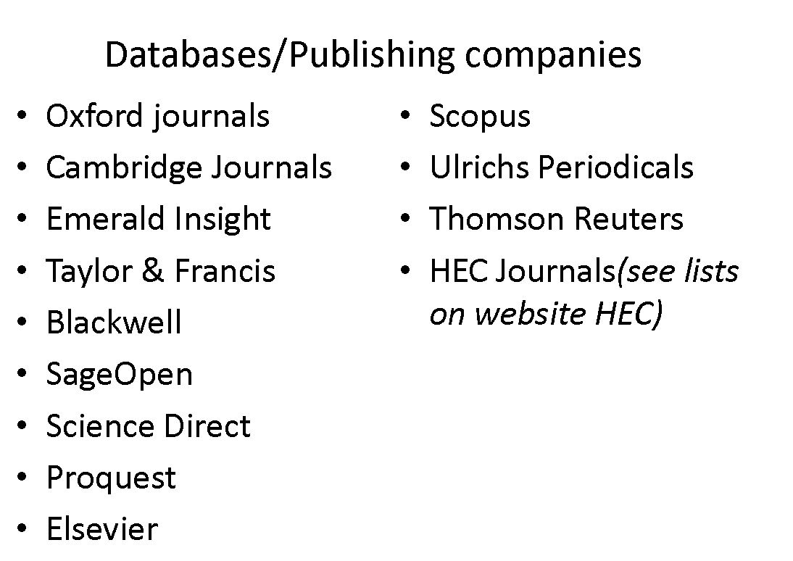
Electronic Databases

Slide 5
Web Search Tips and Techniques
Use two or three search tools.
Know your search tool.
Understand case sensitivity in keyword searches.
Use nouns as search words and as many as eight words in a query.
Use quotation marks.
Omit articles and prepositions.
Proofread your search words.
Save the best.
Keep trying.
Consider searching blogs, wikis, and social networks.

Slide 6



Web Search Tips and Techniques YouTube Thumbnail
https://youtu.be/7ond5eF7L-I
https://youtu.be/s9XZk9CLxK4
https://youtu.be/pUCoERVN_kU

Slide 7
Format
Compiled by Sir Muhammad Ali Khan
Title Page
Abstract or Summary
Introduction
Background/Literature Review
Methodology
Results
Recommendations
Conclusion
References
Attachments

Slide 8
Title Page
Compiled by Sir Muhammad Ali Khan
The essential information here is your name, the title of the project, and the date. Be aware of any other information your instructor requires. The title of a report can be a statement of the subject. An effective title is informative but reasonably short. Ornamental or misleading titles may annoy readers.

Slide 9
Abstract or Summary
Compiled by Sir Muhammad Ali Khan
This section states the report in miniature. It summarizes the whole report in one, concise paragraph of about 100-200 words. It might be useful to think in terms of writing one sentence to summarize each of the traditional report divisions: objective, method, discussion, conclusions. Emphasize the objective (which states the problem) and the analysis of the results (including recommendations). Avoid the temptation to copy a whole paragraph from elsewhere in your report and make it do double duty.
Since the abstract condenses and emphasizes the most important elements of the whole report, you cannot write it until after you have completed the report.
Remember, the abstract should be a precise and specific summary of the report/research.

Slide 10
Difference
(Too general)
This report considers three energy sources and recommends the best one.
(Specific & detailed)
This report compares nuclear plants, fossil fuels, and solar generators, in order to determine which energy source will best meet the nation’s needs. The criteria for comparison were the economic, social, and environmental effects of each alternative. The study concludes that nuclear energy is the best of these options, because North America is not self-sufficient in fossil fuels, and solar power is currently too unreliable for industrial use. Although nuclear plants are potentially very dangerous, nuclear energy is still the best short-term solution.

Slide 11
Introduction
Whereas the abstract summarizes the whole report, the introduction of a technical report identifies the subject, the purpose (or objective), and the plan of development of the report. The subject is the “what”, the purpose is the “why”, and the plan is the “how”. Together these inform the reader with the problem you are setting out to solve.

Slide 12
Background/Literature Review
If the introduction requires a large amount of supporting information, such as a review of literature or a description of a process, then the background material should form its own section. This section may include a review of previous research, or formulas the reader needs to understand the problem. In an academic report, it is also the point where you can show your comprehension of the problem.

Slide 13
Methodology
In this broad area of the report, you would outline the method applied in the research.

Slide 14
Result
The discussion section is the heart of the report – and usually is the most important in terms of the mark you receive! This is where you present your analysis of the issues presented earlier in the report. This is where you interpret, explain and discuss the issues you outlined. In an academic report this is often done by reference to relevant theories, models and practices.
Its basic components are
findings (or results)
evaluation (or analysis)
Mostly in academic reports, the above mentioned components are highly focused.
Before you begin writing, ask the journalist’s questions: who? when? where? what? why? how? The last three in particular will help you focus analysis. Beyond asking these simple questions, you also need to make decisions such as: How do you interpret the data? What is the significance of your findings?

Slide 15
Recommendations
What actions does the report call for? The recommendations should be clearly connected to the results of the rest of the report. You may need to make those connections explicit at this point–your reader should not have to guess at what you mean. This section may also include plans for how further research should proceed.

Slide 16
Conclusion
What knowledge comes out of the report? As you draw a conclusion, you need to explain it in terms of the preceding discussion. Some repetition of the most important ideas you presented there is expected, but you should avoid copying.

Slide 17
Citation & Referencing
Using in-text citation in reports is the way to avoid accusations of plagiarism. It helps tutors and other readers to locate sources you refer to so they can pursue for themselves the ideas or practices you mention.
For example: The School of Management requires students to use the Harvard System. This involves citing the source, e.g. the author, as you write.
Citing the source as you write involves giving a partial or shortened reference (last name of author(s) and year of publication) in the main section of your written assignment and then giving full details of the source in full at the end of the assignment in a ‘references’ section.

Slide 18
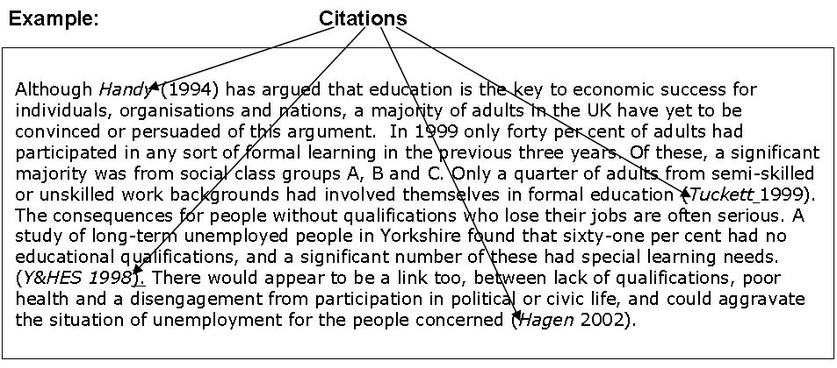
Citations

Slide 19
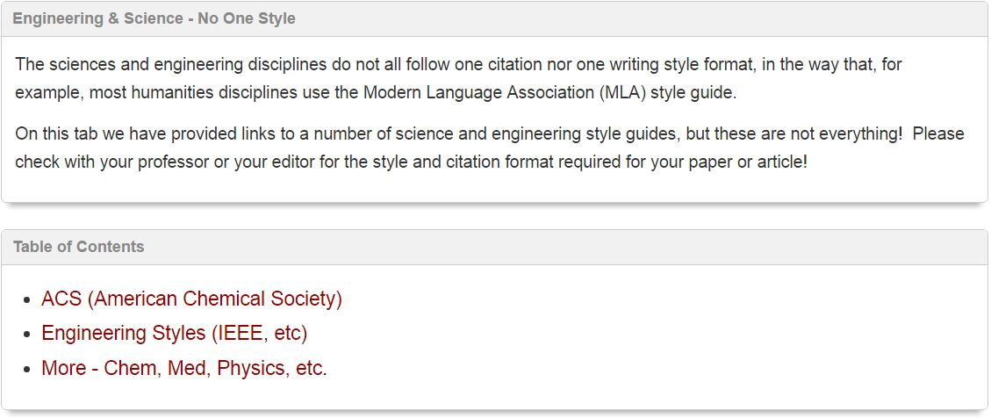
Citation Guide: Science & Engineering

Slide 20
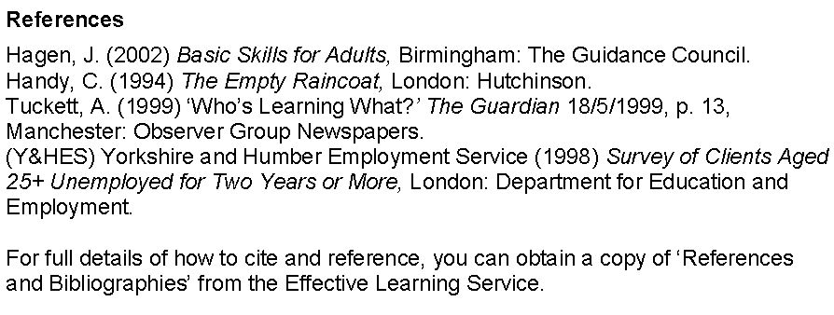
References
At the end of the assignment the references are given in alphabetical order, by last name of the author(s), in full:

Slide 21
Attachments/Appendix
Appendices may include, informed consent form, raw data, calculations, graphs, and other quantitative/qualitative materials/tools that were part of the research. Refer to each appendix at the appropriate point (or points) in your report. In industry, a company profile and profile of the professionals involved in a project might also appear as appendices.

Slide 22
Informative Reports
Reports that present data without analysis or recommendations are primarily informative. Although writers collect and organize facts, they are not expected to analyze the facts for readers.
A trip report describing an employee’s visit to a conference, for example, simply presents information. Other reports that present information without analysis involve routine operations, compliance with regulations, and company policies and procedures.

Slide 23
Cont…..
Writers of informative reports provide information without drawing conclusions or making recommendations. Some information reports are highly standardized, such as hospital admittance reports, monthly sales reports, or government regulatory reports.

Slide 24
Analytical Report
Reports that provide data, analyses, and conclusions are analytical. They also provide recommendations. Analytical reports may intend to persuade readers to act or to change their beliefs.
For example, you are writing a feasibility report that compares several potential locations for a skateboard arena in your institute. After analyzing and discussing alternatives, you might recommend one site, thus attempting to persuade readers to accept this choice.

Slide 25
Task
Compiled by Sir Muhammad Ali Khan
Write a short report on any of the following topics; provide: Introduction, Market Need/ Statement of the problem, Research Question, Software Design, Significance, limitations, Conclusion.
Web-based application for automatic timetable generation
Library management system in C++
Online recruitment system

Slide 26
CONCLUDE

